Slide 1



Foundation Grant: 2016-2017 Competition
Stage 1 webinar will start momentarily
You must join the audio portion of this session
using the integrated voice conference
under the audio menu.
Please note that our microphone will remain muted
until the start of the webinar.

Slide 2
Foundation Grant: 2016-2017 Competition webinar
Stage 1 Application
Dale Dempsey, Manager, Foundation Grant September 2016

Slide 3



3

Slide 4
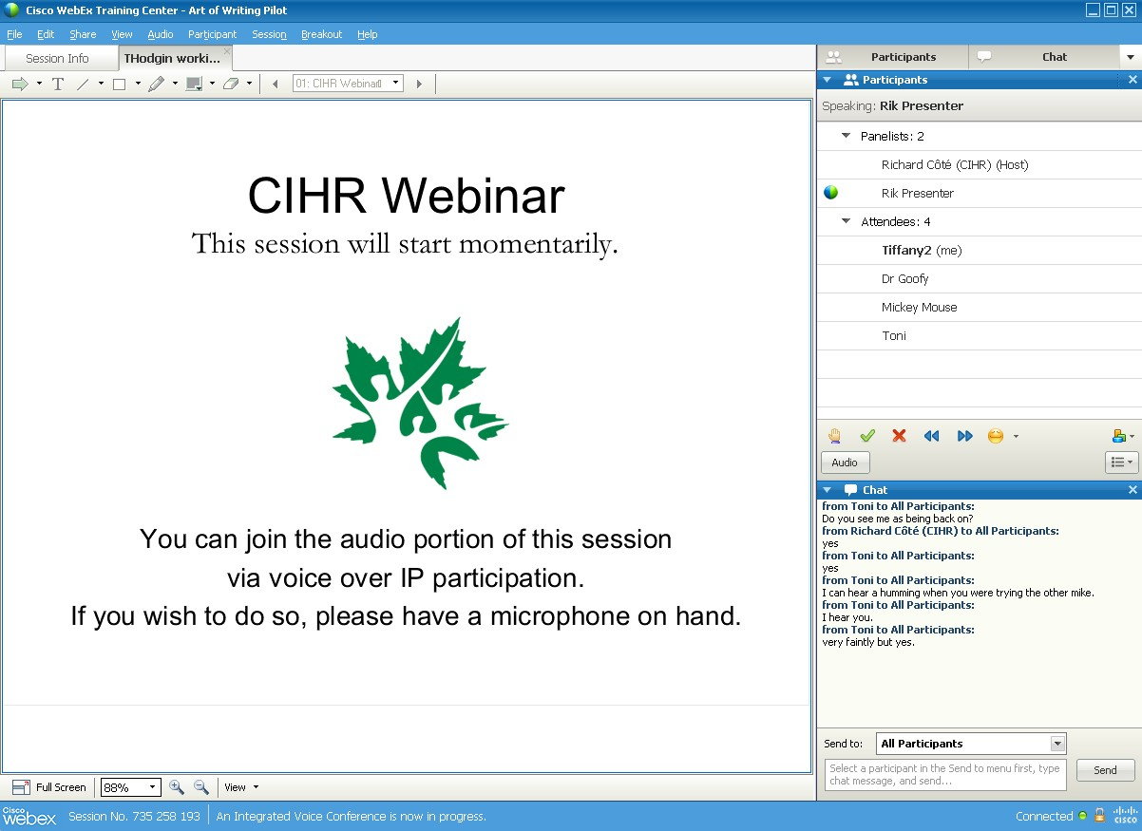

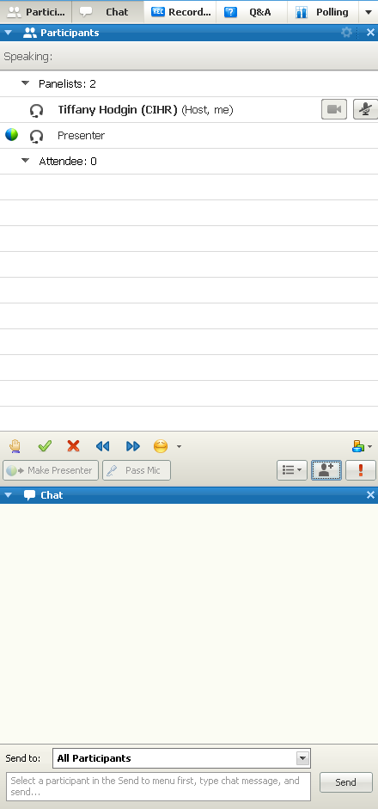

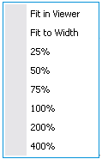
4

Slide 5

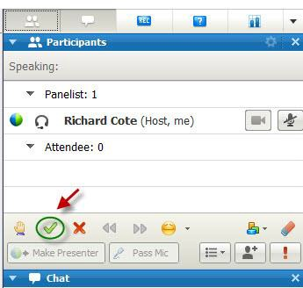
5

Slide 6





Session Outline
6
Foundation Grant: 2016-2017 Competition -
Stage 1 Application
Updates and changes Provide an overview of the
Stage 1 application
Provide an opportunity for participants to ask questions

Slide 7

2015-2016 Foundation Grant
Competition Results
7
910 applications received.
  265 new/early investigators
  645 mid-career/ senior investigators
265 invited to Stage 2 – 260 submitted
  77 early/career investigators
  183 mid-career/ senior investigators
96 invited to the final assessment stage.
120 applications were funded, 33 of which were from new/early career investigators.

Slide 8
Foundation Grant: 2016-2017
Competition Timelines
8
Key Dates
Registration Deadline
September 13, 2016
Application Deadline – Stage 1
October 13, 2016
Anticipated Notice of Decision – Stage 1
February 2, 2017
Application Deadline – Stage 2
March 14, 2017
Anticipated Notice of Decision – Final Assessment Stage
August 3, 2017
Funding Start Date
July 1, 2017

Slide 9
9
Updates and Changes

Slide 10
Eligibility
10
First Foundation competition where the restriction criteria for
Program Leaders (associated with the Pilots) have been lifted
  Competition is now open to all independent researchers with an academic or research appointment (regardless of grant expiry dates)
The following policies remain in place:
  If you are successful in the Foundation Competition, all of your existing CIHR Open grants held as a Nominated Principal Applicant will be rolled into your Foundation grant
  Applicants cannot submit the same or similar application to overlapping competitions. If, at Stage 2, it becomes obvious that the same application was submitted to the Project Grant competition, you will be asked to withdraw one of the applications.
  )

Slide 11

11
Stage 1 application
A Lay abstract is no longer required for the stage 1 application
Applicants who have taken leaves of absence may include a PDF to supplement the publication information in CCV

Slide 12
Six Descriptors
12
Six elements provide CIHR with information on the type
of expertise required to review application
Descriptors
Themes
Suggested Institutes
Areas of Science
Methods/Approaches
Study Populations and Experimental Systems
Information collected in your registration and Stage 1 application will be used to match the most appropriate expert reviewers to your application.

Slide 13

13
Stage 1 Application: Overview

Slide 14
CIHR Foundation Grant CV
14
Your CV should be customized at Stage 1 to reflect the focus
and requirements of this stage
Point to relevant examples in your CV, as appropriate, to demonstrate:
  Leadership
  Significance of Contributions
  Productivity
If applying with other Program Leaders, you must include relevant examples of joint activities in your CV (e.g., authorships, grants and publications) to illustrate synergy, co-leading history and joint efforts

Slide 15
Adjudication Criteria
15
Application sections align with the Foundation Grant
adjudication criteria
You will address each section in a defined text box with a specific character limit, which includes spaces
Adjudication Criteria Stage 1 focuses on:
  Caliber of the Applicant(s)
✓ Leadership
✓ Significance of Contributions
✓ Productivity
  Vision and Program Direction

Slide 16
Application
16
No other participants may be added to the application at
stage 1
Program Experts can be added only at stage 2
Applications must be submitted by the Administrative
Coordinator – Program Leader using ResearchNet
It is your responsibility as the Program Leader/Administrative Coordinator to ensure
that your application is complete and sent to your institution paid as part of the eApproval process

Slide 17
Multiple Program Leaders
17
All Program Leaders have access and edit rights to the application but only the Administrative Coordinator can submit the application
Program Leaders are responsible for including their own information in
ResearchNet:
  Linking their CIHR Foundation CV to application
  Identifying their career contributions
  Adding additional CV information – Leaves of absence
  Providing their consent
Team must convincingly demonstrate synergy, a history of co-leading research, evidence of joint efforts that resulted in the achievement of tangible benefits and impact, and the co-generation of research output.
  Assessment of each adjudication criterion will consider both the individual and joint research contributions of the Program co-Leaders.

Slide 18

New/Early Career Investigators
18
A key component of the Foundation Grant program is a
separate cohort for the new/early career investigators
The new/early career investigators will be assessed and ranked against other new/early career investigators at each stage of the adjudication process.

Slide 19
Tasks required for completing a
Foundation Grant application
19
Complete Canadian Common CV
Complete the ResearchNet application
  Identify Participants
  Enter Proposal Information
  Complete Summary
  Complete Application
  Complete Peer Review Administration Information
Preview
Consent and Submit

Slide 20

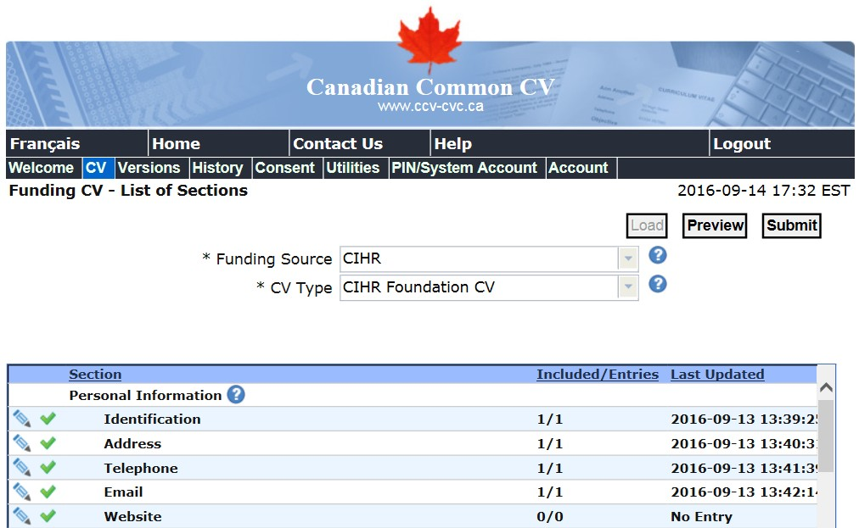
Canadian Common Foundation CV
20

Slide 21


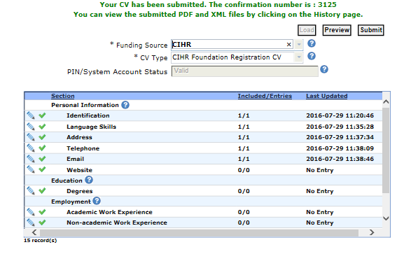
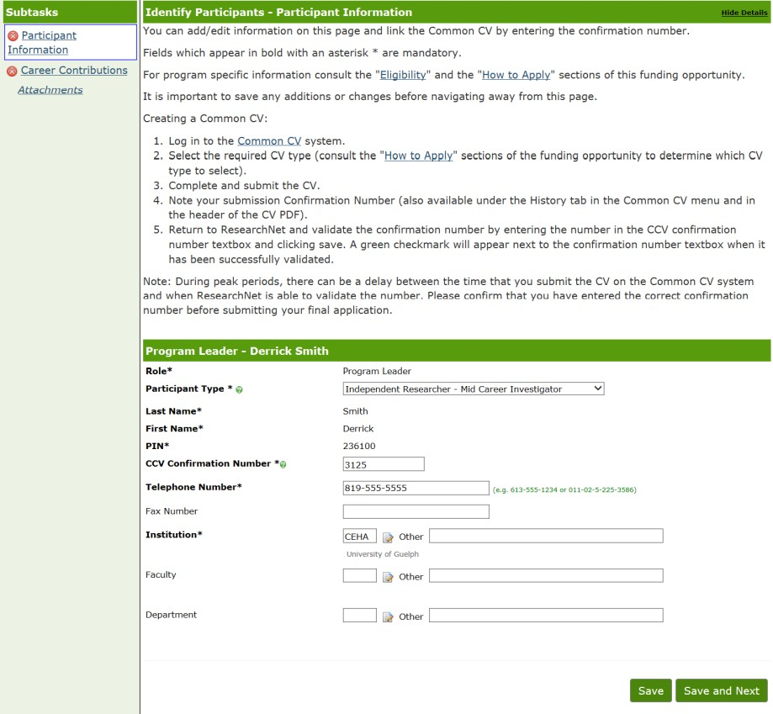
Confirmation number from CCV
21

Slide 22

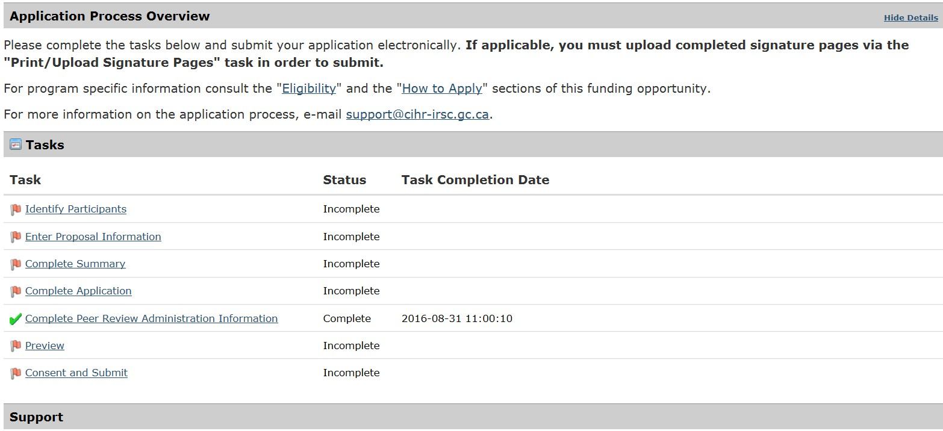
Tasks required
22

Slide 23

Task 1: Identify Participants
23

Slide 24

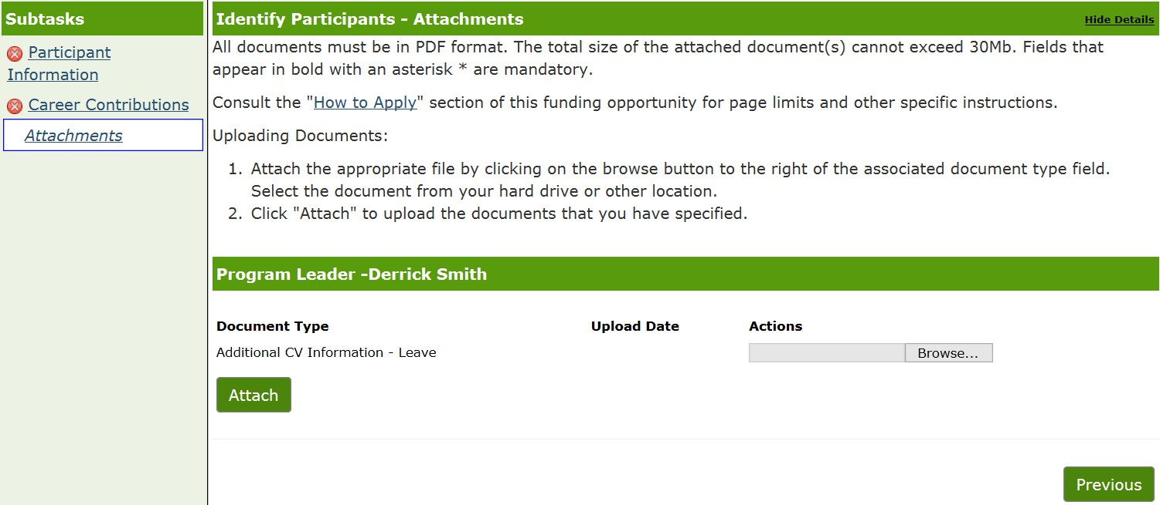
Task 1: Identify Participants
24

Slide 25

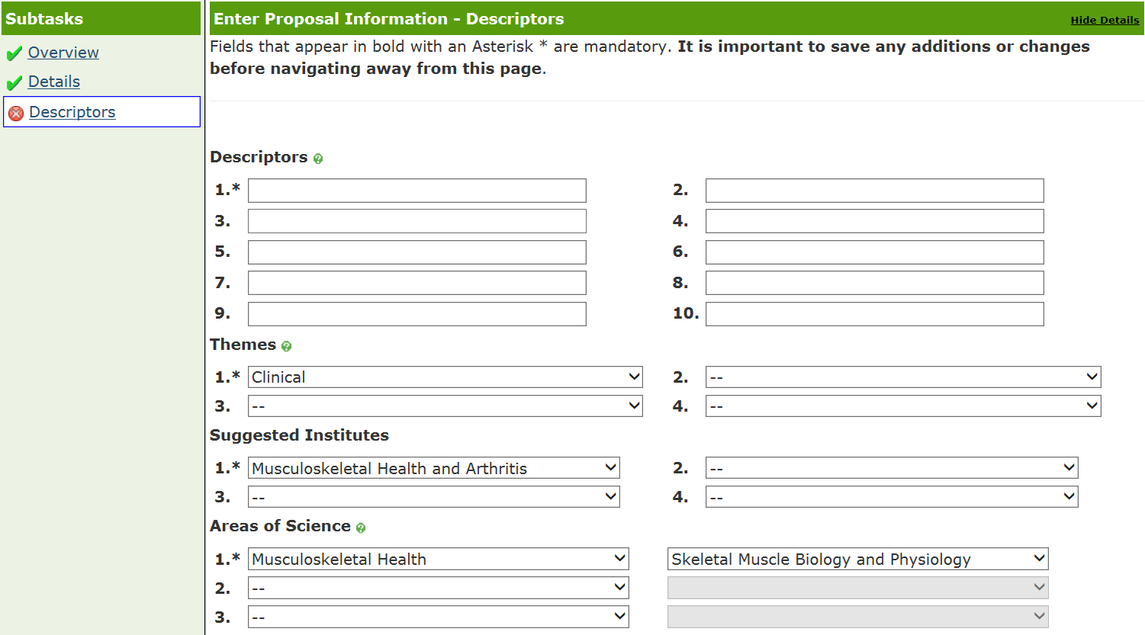
Task 2: Enter Proposal Information
25

Slide 26

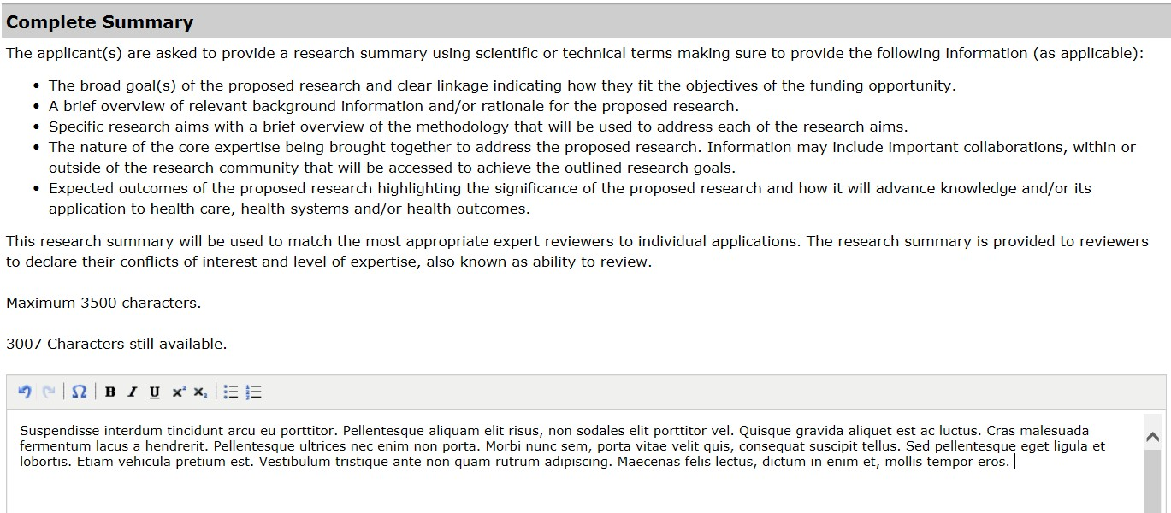
Task 3: Complete Summary
26

Slide 27

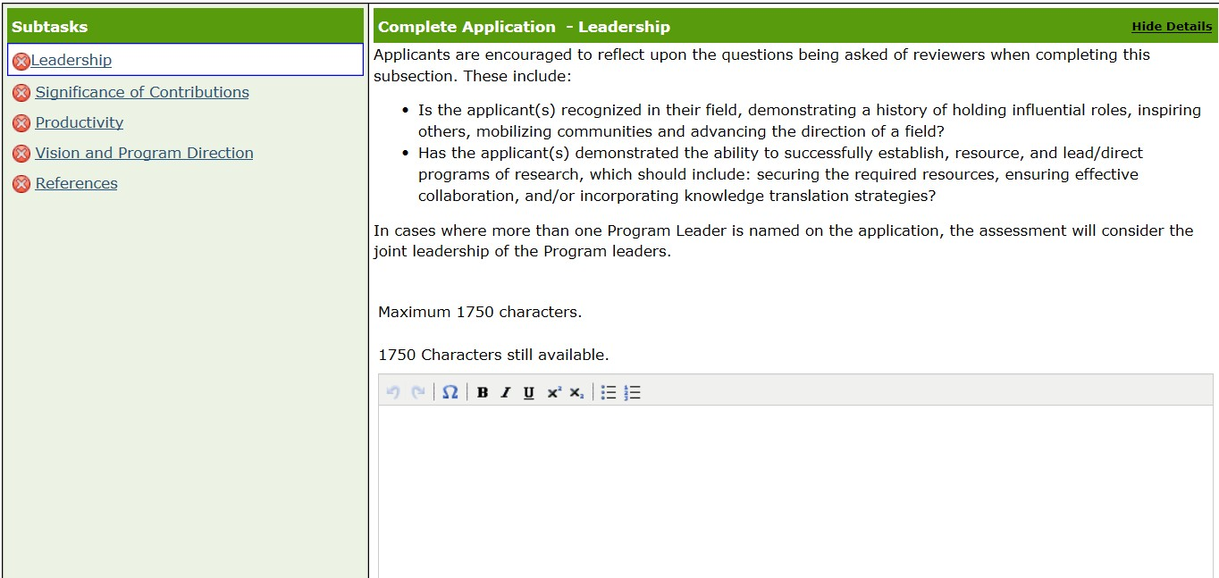
Task 4: Complete Application
27

Slide 28

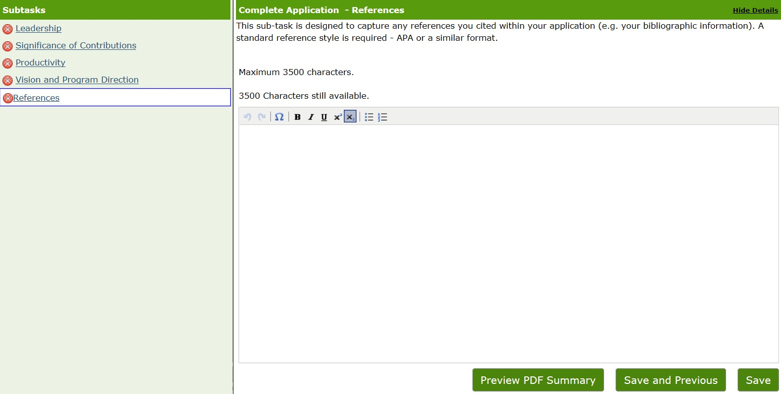
Task 4: Complete Application
28

Slide 29


Task 5: Complete Peer Review
Administration Information
29
Suggest a minimum of 5 Canadian and/or foreign reviewers that you feel have the expertise to review your application
Identify any individuals to exclude as reviewers (if applicable)

Slide 30



Foundation Grant: 2016-2017 Competition
30
Supporting materials
Applicants and Research Administrators
Funding Opportunity
Stage 1 & Stage 2 Application Instructions Foundation CV – Quick Reference Guide
Role Definitions / Eligibility
Stage 1 - Applicant eLearning Module
(September 2016)
Stage 1 - Q & A webinars (September – October 2016)
Stage 2 - Applicant eLearning Module
(February 2017)
Stage 2 - Budget eLearning Module (February 2017)
Reviewers
Peer Reviewer Manual - Foundation (Includes
Interpretation Guidelines)
Stage 1 - Reviewer eLearning Module
(October - November 2016)
Stage 2 - Reviewer eLearning Module
(February – March 2017)

Slide 31

31
Questions and Answers

Slide 32


32
Contact Information
At any time, questions regarding the Foundation Grant Competition can be directed to the CIHR Contact Centre:
Thank you!
Toll Free: 1-888-603-4178
Phone: 613-954-1968
Fax: 613-954-1800
Email: support@cihr-irsc.gc.ca
Website: http://www.cihr-irsc.gc.ca

